Slide 1
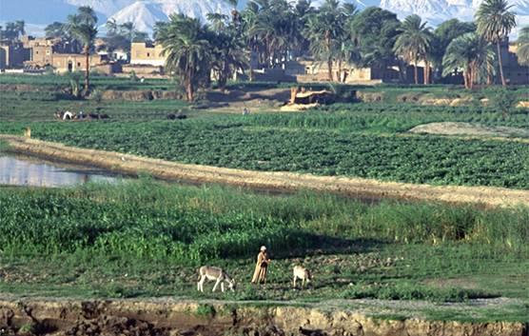
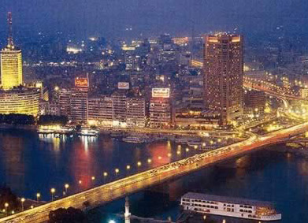
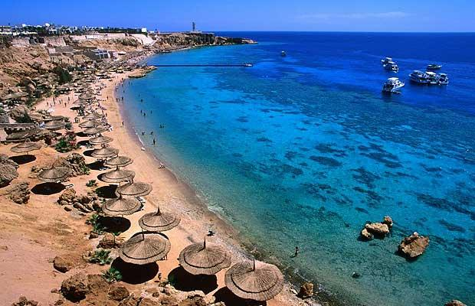
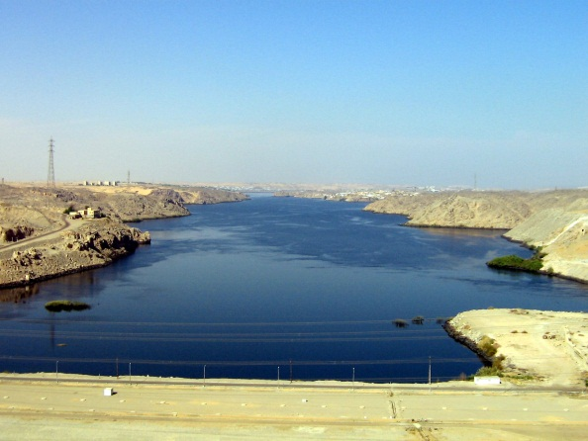
Potential Impacts of Climate Change on the Egyptian Economy
Presented by Mona El Agizy

Slide 2
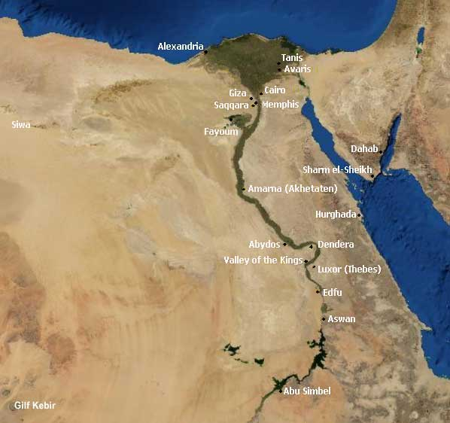
We Examined
Water supplies
Agriculture
Coastal Resources
Tourism
Air Quality
Biodiversity: Coral Reefs
Notes:
https://www.cia.gov/library/publications/the-world-factbook/geos/eg.html. Accessed Sept. 15, 2011

Slide 3
Key Aspects of This Study
It is a collaboration
We used estimates of change in:
    Water supply
    Crop Yields
    Inundation of Nile Delta
  From Egyptian Government and Egyptian Researchers
We developed estimates of economic impacts

Slide 4
Scenarios

Slide 5
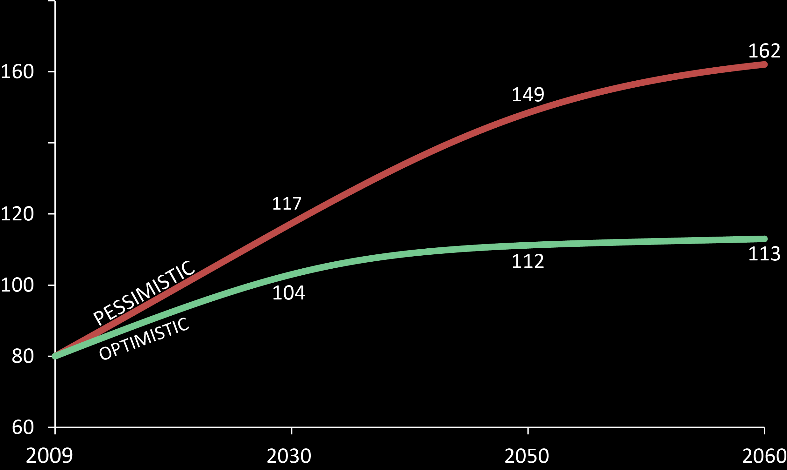
Socioeconomic Scenarios: Population
Notes:
Population through 2030 from Egypt SNC. Population through 2050 from UN. 2060 is Stratus’ extrapolation. Optimistic GNP is from IPCC SRES A1 scenario for Africa; Pessimistic is from IPCC SRES A2 scenario for Africa.

Slide 6
Socioeconomic Scenarios: Income
Notes:
Population through 2030 from Egypt SNC. Population through 2050 from UN. 2060 is Stratus’ extrapolation. Optimistic GNP is from IPCC SRES A1 scenario for Africa; Pessimistic is from IPCC SRES A2 scenario for Africa.

Slide 7
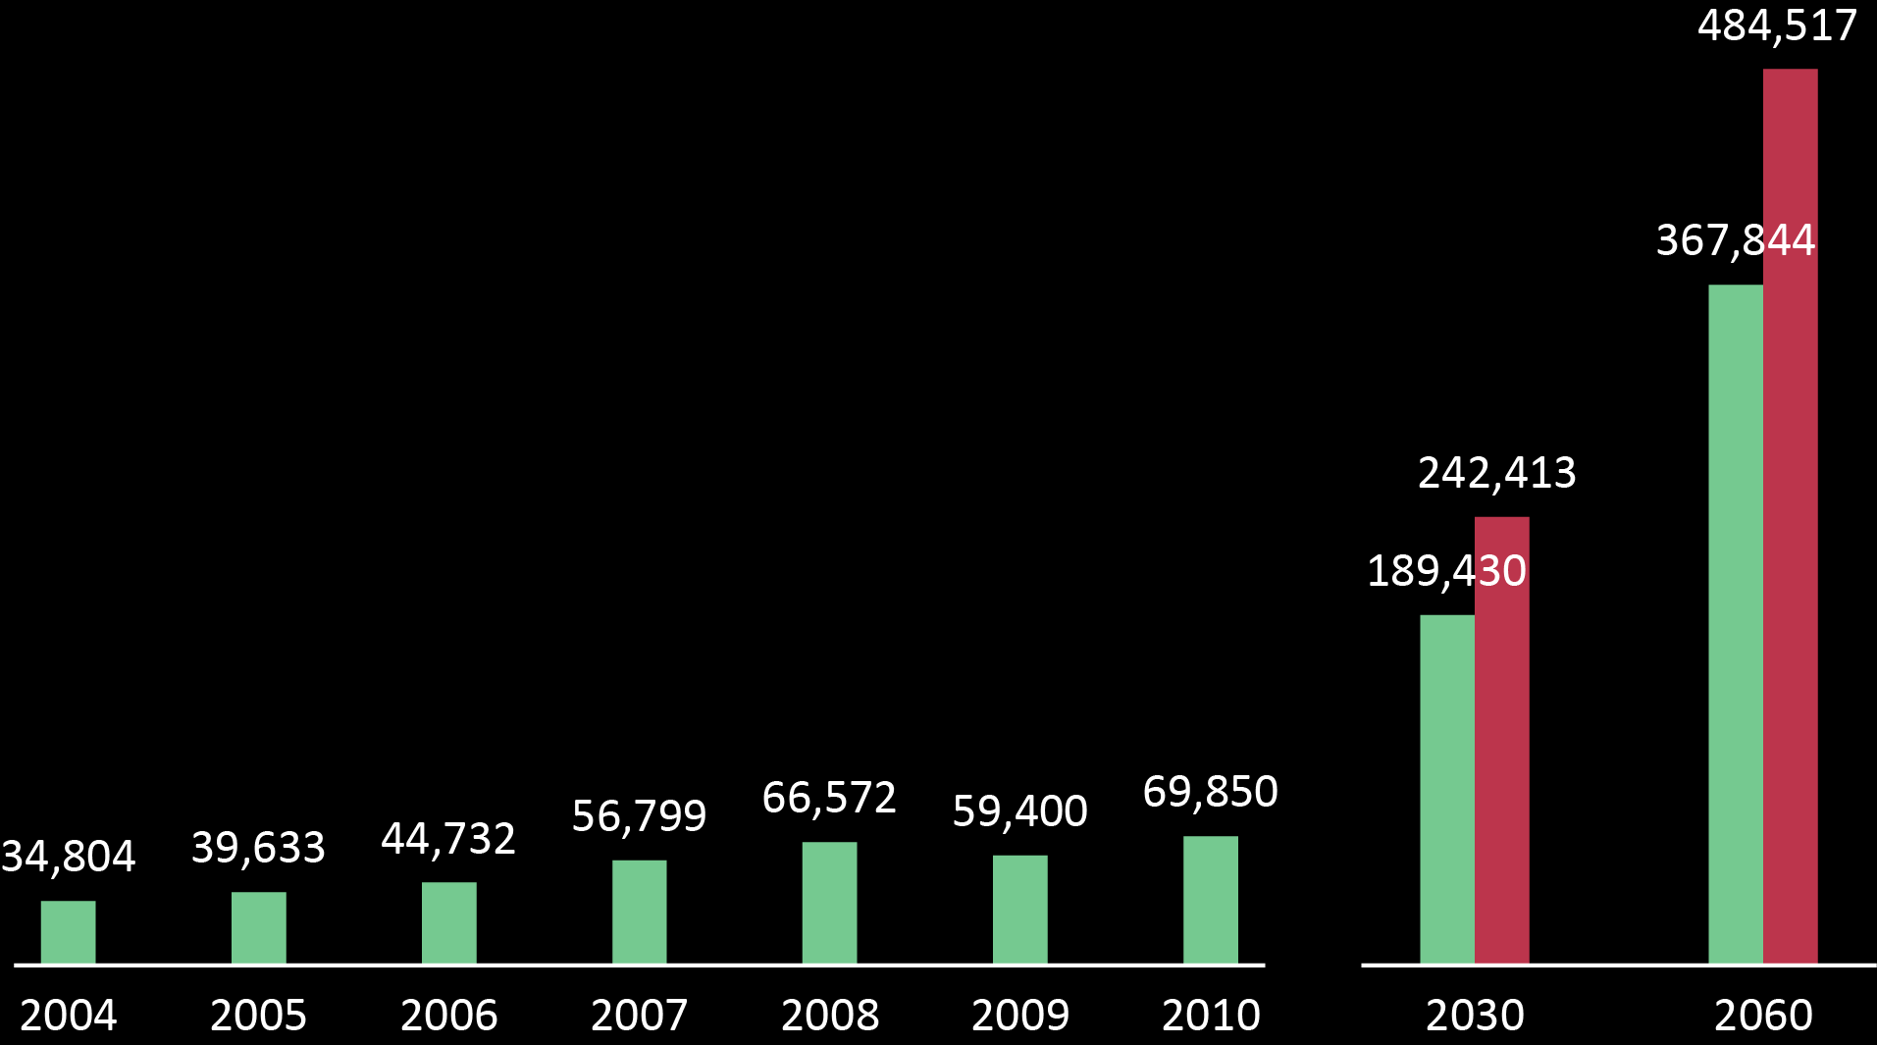
Tourism Projections
Recorded and estimated tourism revenues
(Expenditures – millions EGP)
Extrapolations (pessimistic/optimistic)

Slide 8
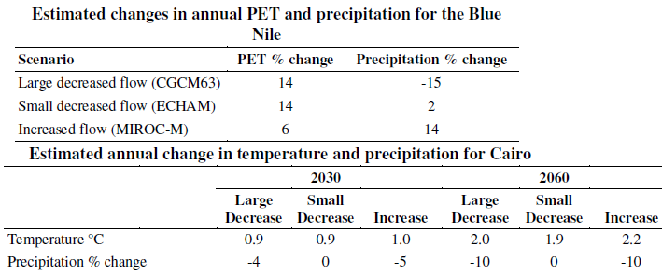
Climate Change Scenarios
Sources: Elshamy Personal Communication. 2011 on Blue Nile

Slide 9
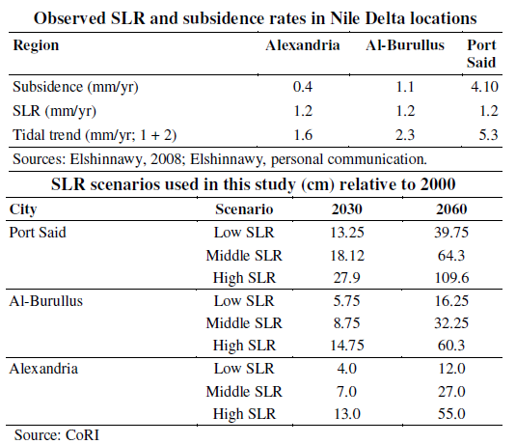
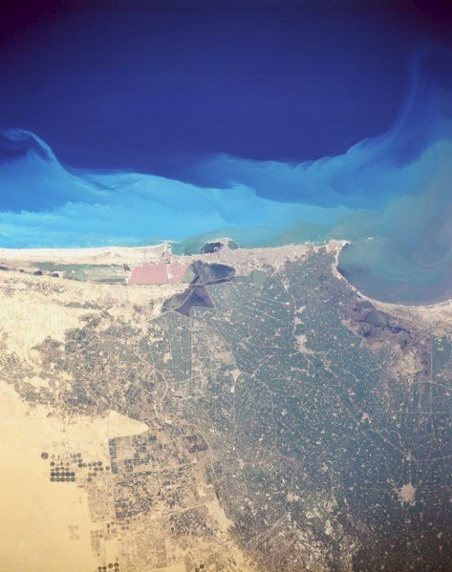
Sea Level Rise Scenarios

Slide 10
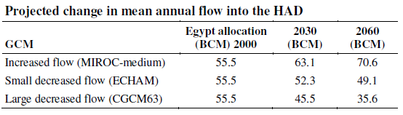

Change in Flows into High Aswan Dam
Notes:
http://www.google.com/imgres?q=high+aswan+dam&hl=en&gbv=2&tbm=isch&tbnid=SHXFYKVDr3aGIM:&imgrefurl=http://pt.wikipedia.org/wiki/Ficheiro:Aswan_High_Dam.jpg&docid=zlq9C-V5HpKJuM&w=2048&h=1536&ei=mlVyTotyhPDSAf6D-IgG&zoom=1&iact=hc&vpx=540&vpy=376&dur=3734&hovh=194&hovw=259&tx=130&ty=220&page=2&tbnh=138&tbnw=188&start=12&ndsp=12&ved=1t:429,r:6,s:12&biw=1024&bih=674. Accessed Sept. 15, 2011

Slide 11
Results

Slide 12
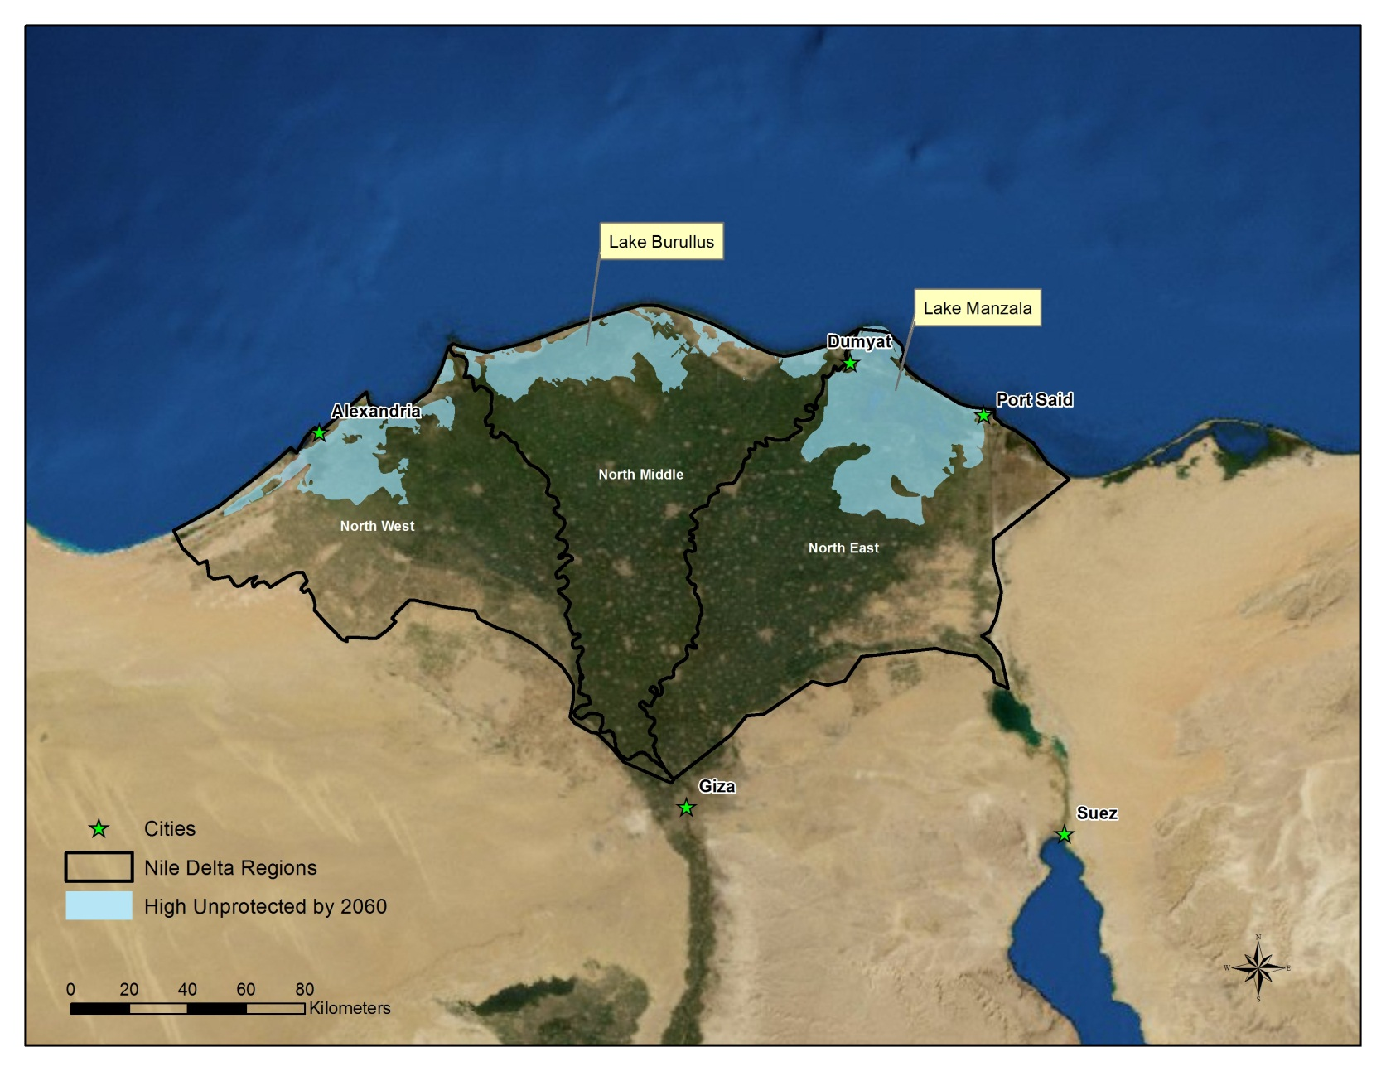
Impacts of High Sea Level Rise on Nile Delta
Inundation of Agriculture Lands
Inundation data supplied by CoRI

Slide 13
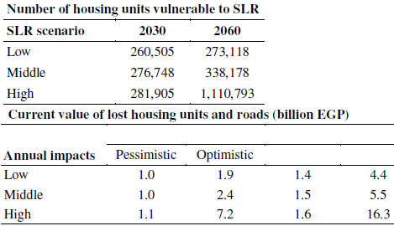
Impacts of Sea Level Rise on Nile Delta
Risks to Homes and Roads

Slide 14
Change in Crop Yields
Based on Results Reported in Egyptian SNC

Slide 15
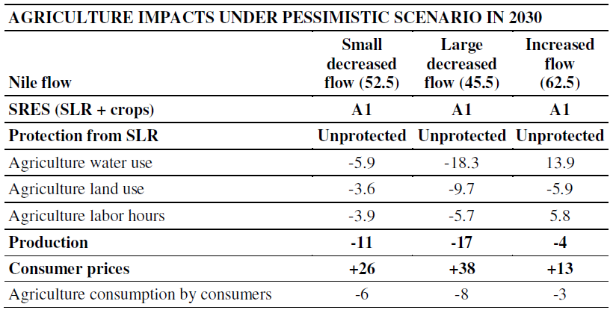
Effects on Agriculture Production: 2030
% Change

Slide 16
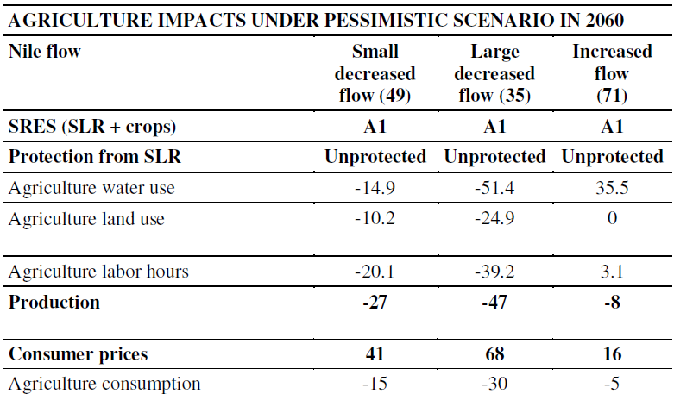
Effects on Agriculture Production: 2060
% Change

Slide 17
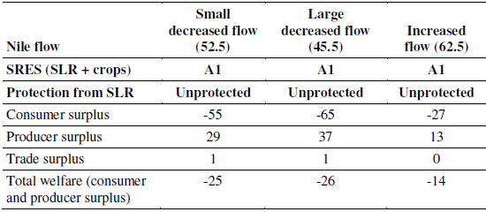
Change in Agriculture Annual Welfare 2030
(billions EGP)

Slide 18
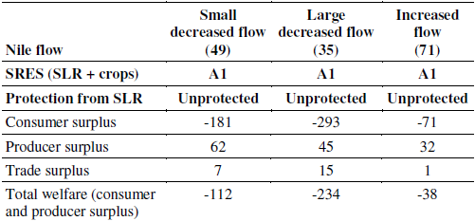
Change in Agriculture Annual Welfare 2060
(billions EGP)

Slide 19
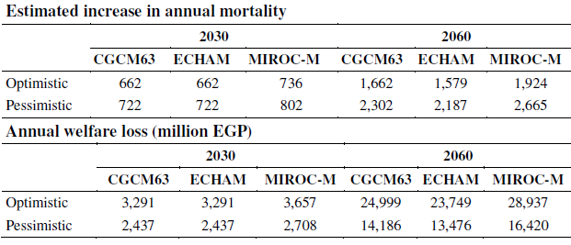
Effect of Increased Heat Stress in Cairo

Slide 20
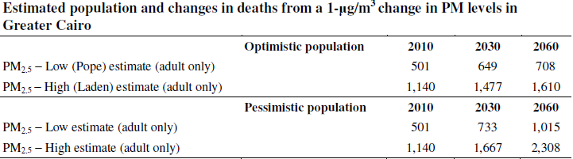
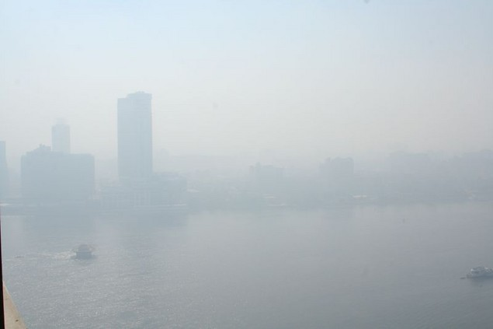
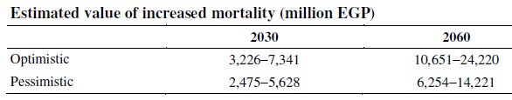
Change and Value of Additional Air Pollution in Cairo: Particulate Matter
Notes:
http://www.google.com/imgres?q=Air+pollution+Cairo&hl=en&gbv=2&tbm=isch&tbnid=cYl7zldxPKpgnM:&imgrefurl=http://www.nowpublic.com/health/nile-river-cairo-air-pollution-smog-and-haze&docid=O1gjNbPz2Hhy5M&w=635&h=423&ei=el1yTpaeOYbn0QGOpeiGCg&zoom=1&biw=1024&bih=674&iact=rc&dur=94&page=1&tbnh=146&tbnw=187&start=0&ndsp=12&ved=1t:429,r:1,s:0&tx=85&ty=114. Accessed Sept. 15. 201

Slide 21
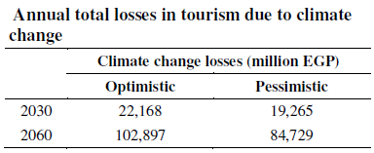
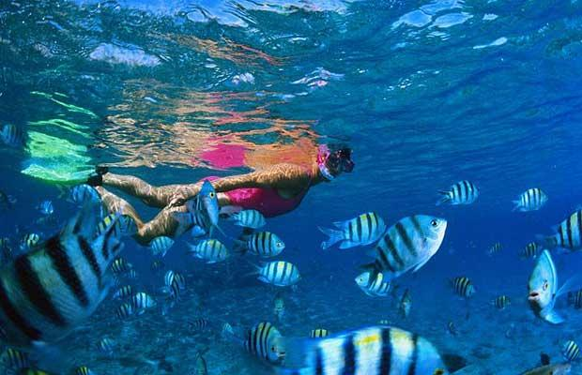
Estimated Impacts on Tourism
Notes:
http://www.google.com/imgres?q=Red+Sea+resorts&hl=en&gbv=2&tbm=isch&tbnid=_aw6hXVVxJt35M:&imgrefurl=http://www.telegraph.co.uk/travel/sunandsea/4538614/The-best-of-the-Red-Sea-Riviera.html%3Fimage%3D1&docid=kWnzqXAupze02M&w=620&h=400&ei=yF5yTqP0PIfH0AH1rKWiCg&zoom=1&biw=1024&bih=674&iact=rc&dur=156&page=1&tbnh=152&tbnw=203&start=0&ndsp=12&ved=1t:429,r:1,s:0&tx=83&ty=88. Accessed Sept 15. 2011.
http://www.google.com/imgres?q=Red+Sea+resorts&hl=en&gbv=2&tbm=isch&tbnid=kNXAzd0fp4orjM:&imgrefurl=http://www.telegraph.co.uk/travel/sunandsea/4538614/The-best-of-the-Red-Sea-Riviera.html&docid=wwP8L9dYcZiY7M&w=620&h=400&ei=yF5yTqP0PIfH0AH1rKWiCg&zoom=1&iact=hc&vpx=702&vpy=163&dur=250&hovh=180&hovw=280&tx=167&ty=122&page=1&tbnh=152&tbnw=203&start=0&ndsp=12&ved=1t:429,r:3,s:0&biw=1024&bih=674. Accessed Sept 15. 2011

Slide 22
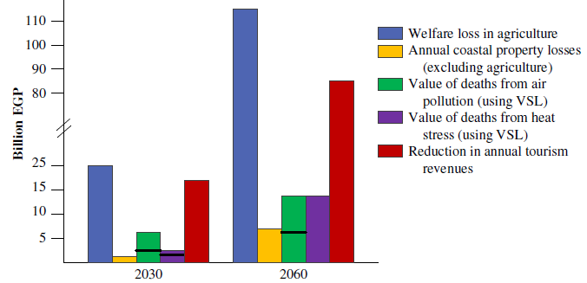
Summary of Economic Impacts

Slide 23
Key Economic Impact
 | 2030 | 2060
GDP | 1.6 – 2.4 % GDP | 2.1 – 6.0 % GDP

Slide 24
What is Not Accounted For
Natural Resource Impacts (outside of corals and tourism)
  Biodiversity
Other human health effects
  Water resources
  Disease
Total costs of sea level rise
  Defense costs or all lost property

Slide 25
Concluding Thoughts
Egypt appears to be facing potentially serious economic and social risks from climate change
Reduction in GHGs will reduce risks to some extent
  Particularly of extreme climate change
Adaptation can ameliorate some of these risks
  Adaptation will be critical

Slide 26
PROBLEM
IMPACT
SOLUTION

Slide 27
Government
PROBLEM
Economic Impact
Policy Change

Slide 28
Main Key Adaptations in the Water Sector
Water Management
Enhancement of Supplies
Demand Reduction
Coastal Resource Protection

Slide 29
Main Key Adaptations in the Agriculture Sector
Optimal Use of on-farm water resources
Cropping Pattern for Water Management
Certified Seeds
Stress tolerant Crop Selection for Climate Conditions

Slide 30


Thank you!
For your attention
Group: Climate Change Leadership in Egypt
www.eeaa.gov.eg/ccrmp

